Slide 1
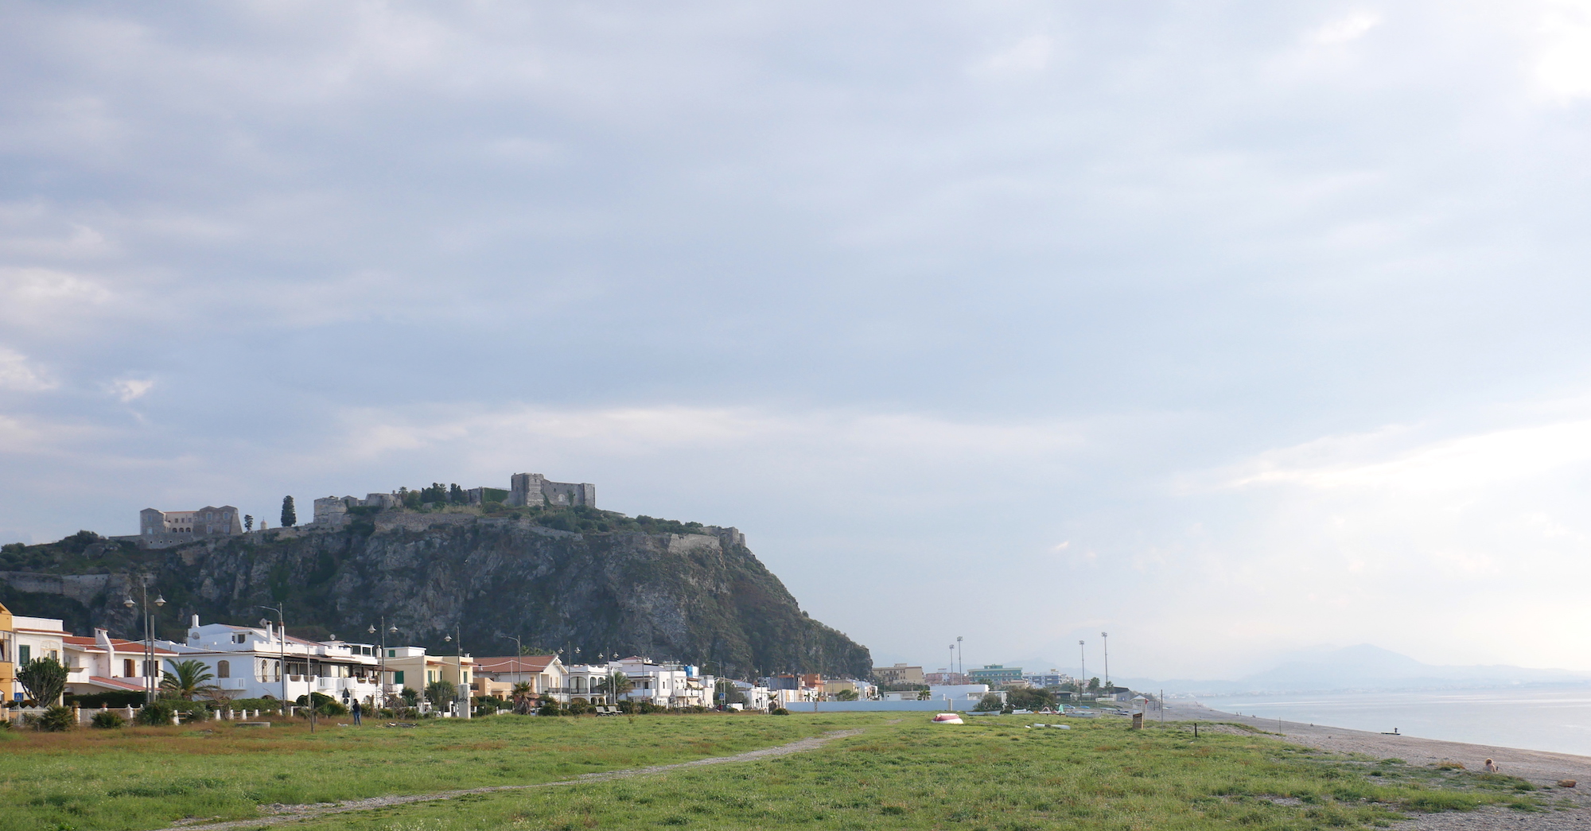
How are you, Milazzo?
Come stai Milazzo? Wie geht es dir, Milazzo?
Comment ça va, Milazzo?
Notes:
Buona sera, tutti! Do you feel good?
This week we came to Milazzo from all over Europe.
Martin and I came here for the first time
and we met lots of wonderful people!
Milazzo is a beautiful place!
We were asked:
What idea do you have to support the people of Milazzo?
And this is our proposal: “How are you, Milazzo?”
To make this idea happen, we need you all!
Let me explain ...

Slide 2

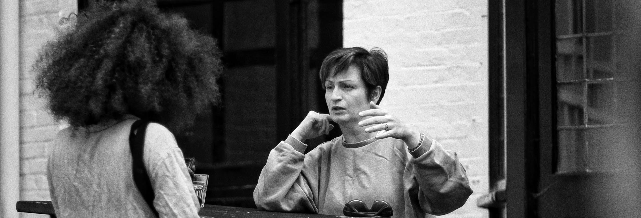
Knowledge
Conoscenza・Wissen・Connaissance
Notes:
If you want to know how Milazzo feels, how would you do this?
Well, it's all about knowledge!
And to gain knowledge we need data.
And to get data we can use sensors:
Water quality sensors
Air quality sensors
Noise sensors
Traffic sensors
etc.
It’s important to share this knowledge with everyone.
Because with knowledge we have power.

Slide 3
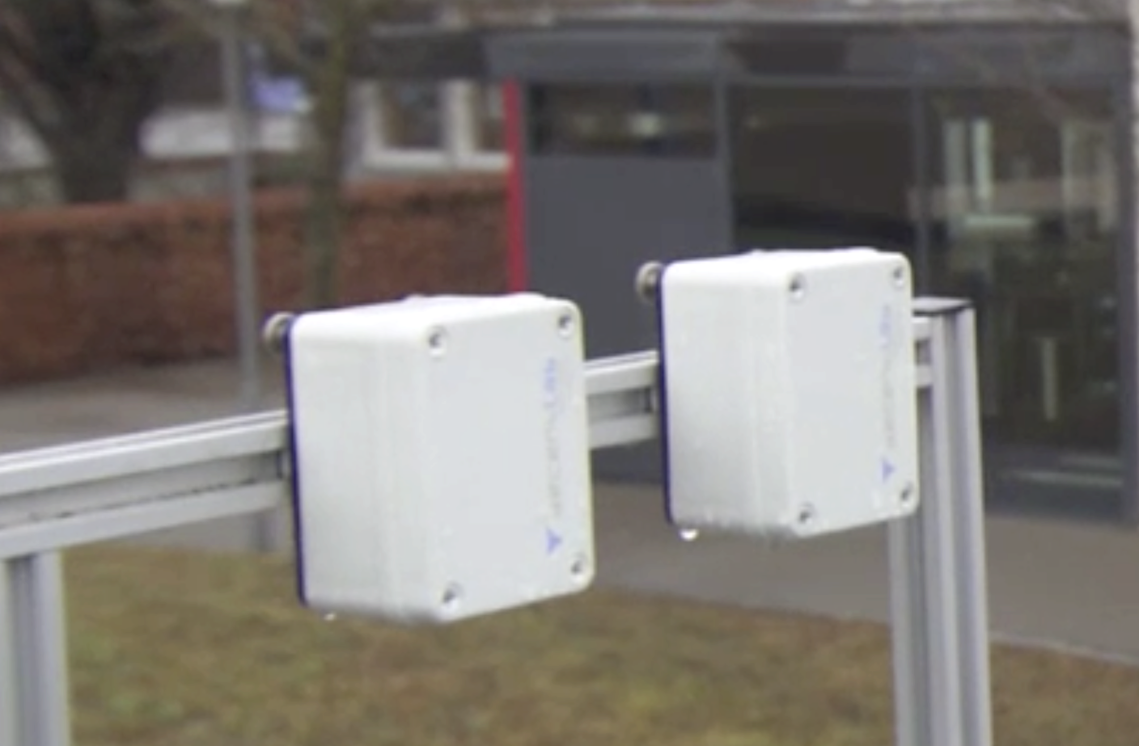
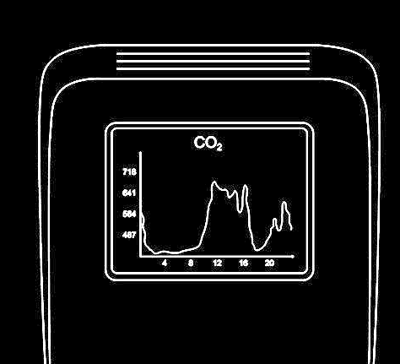
Sensors
Sensori・Sensoren・Capteurs
Notes:
Maybe you say now, that there are already many sensors in the city. That’s right.
But today most sensors are in control of others:
Government
Businesses (like chemical industry)
Private people
… and they do not share their data.
Wouldn’t it be a great idea to build a community that
Install sensors all around the city
makes sensor data accessible to everyone
So here is our deal:
You care about the sensors,
We help you to make the data accessible as Open Data!

Slide 4
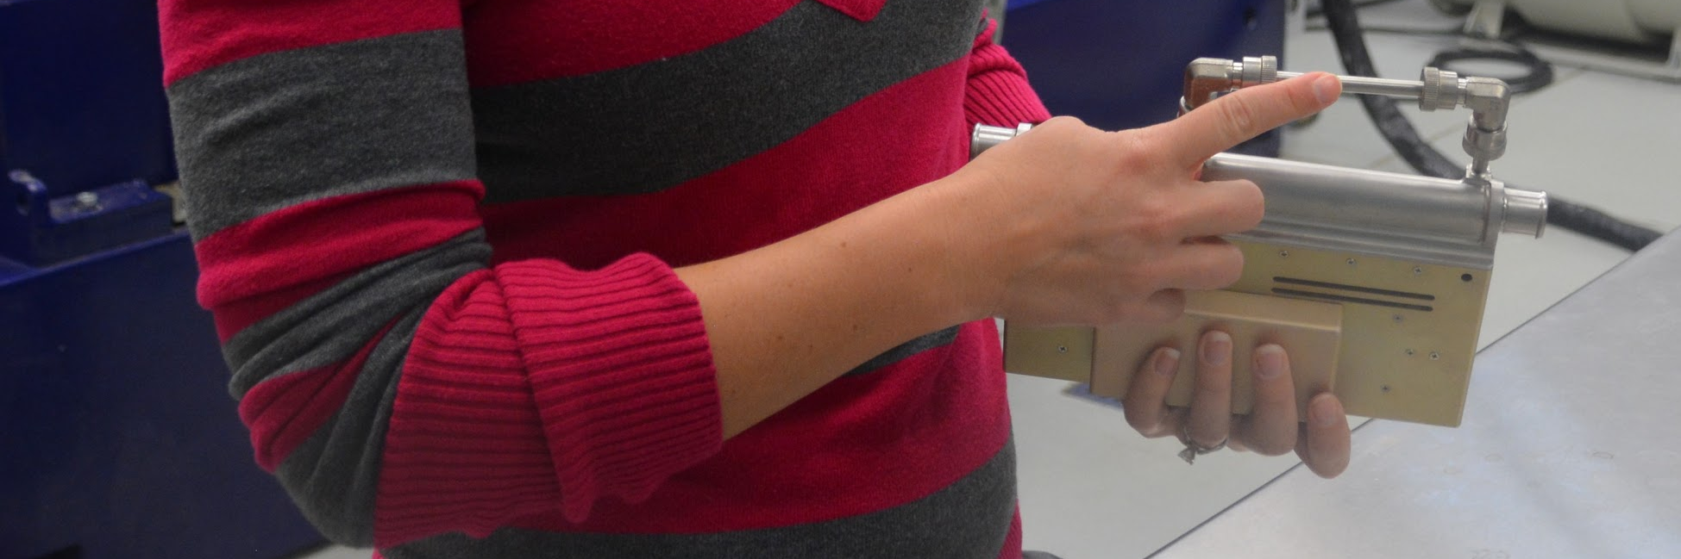
Trust
Fiducia・Vertrauen・Confiance
Notes:
And we know, that our sensors tell the truth!
You can trust this data!
It’s Open Data (and accessible for everyone)
It’s Our Data (we own the data)
It makes us independent from others
There is transparency and anonymity
And our data is free to use

Slide 5
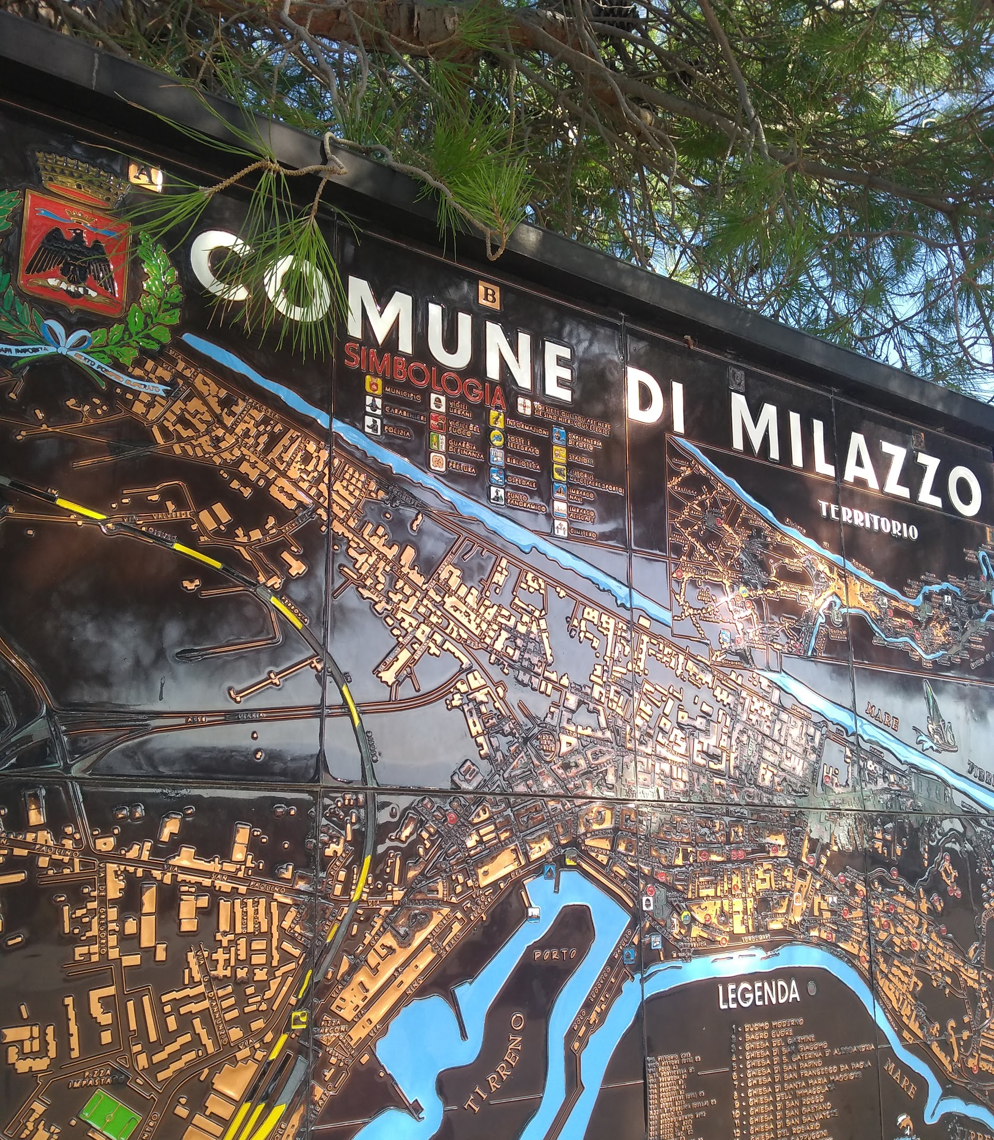
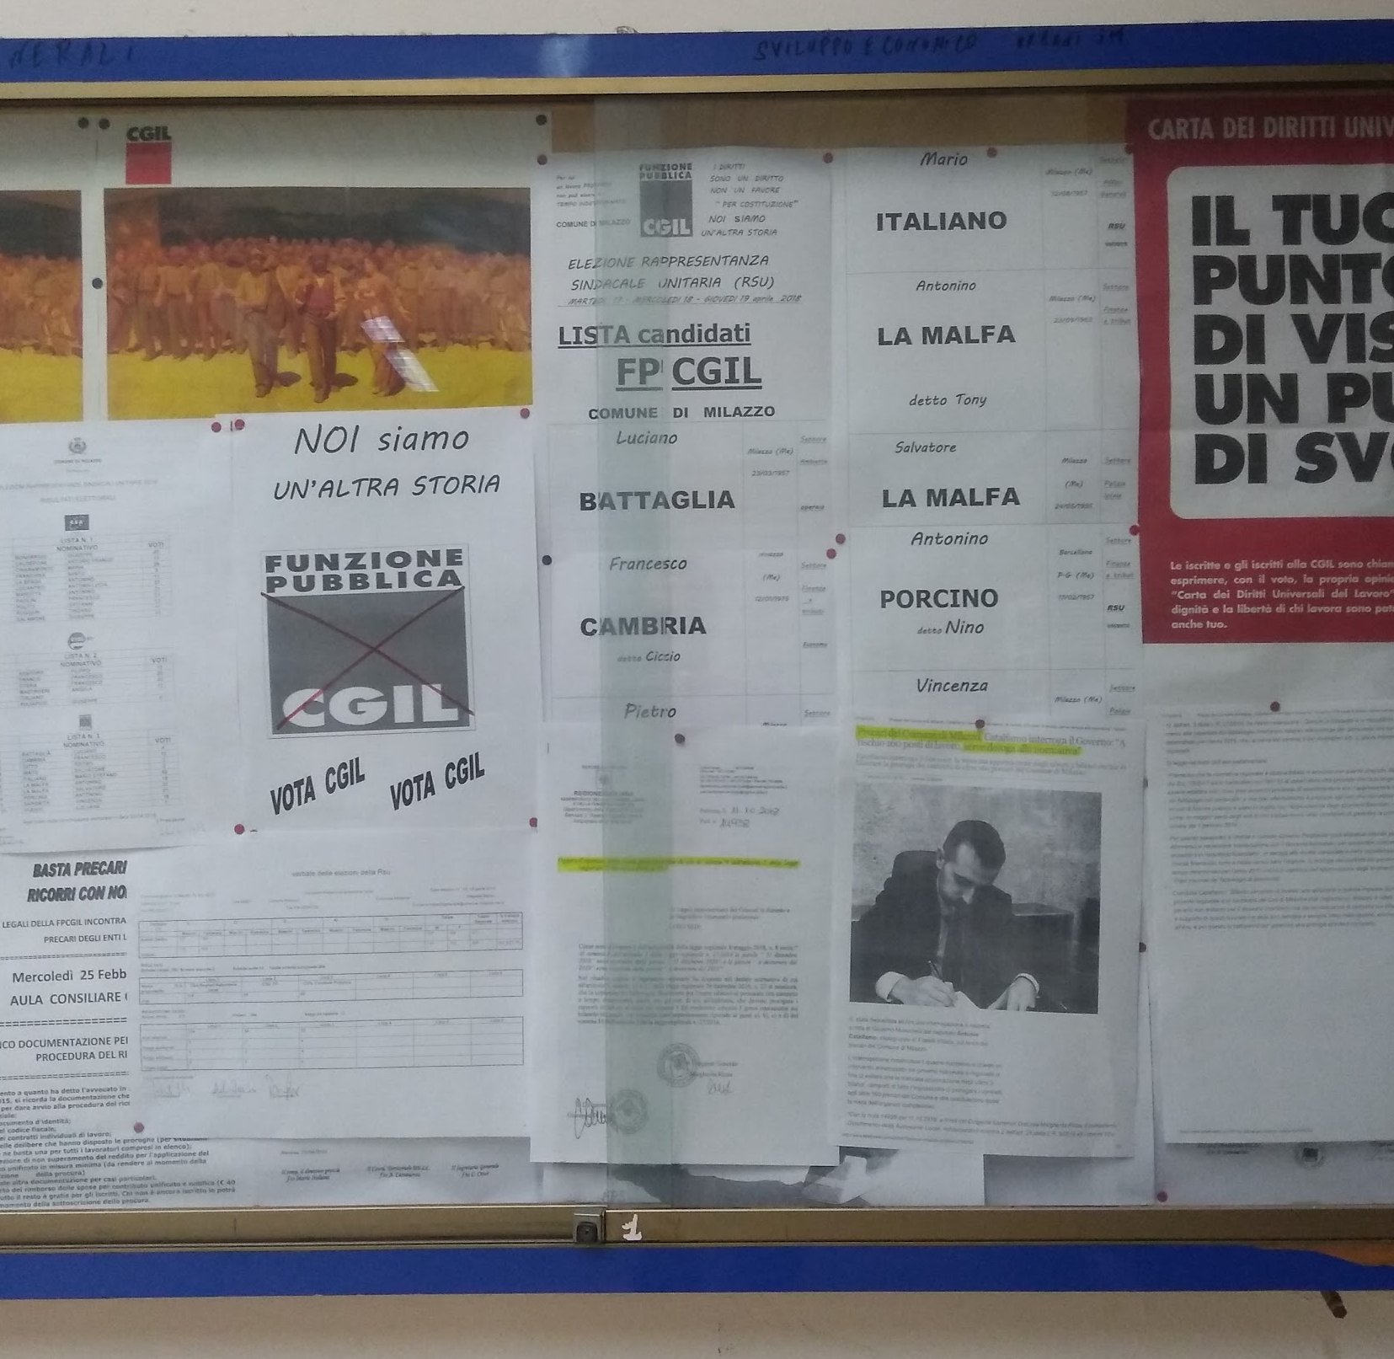
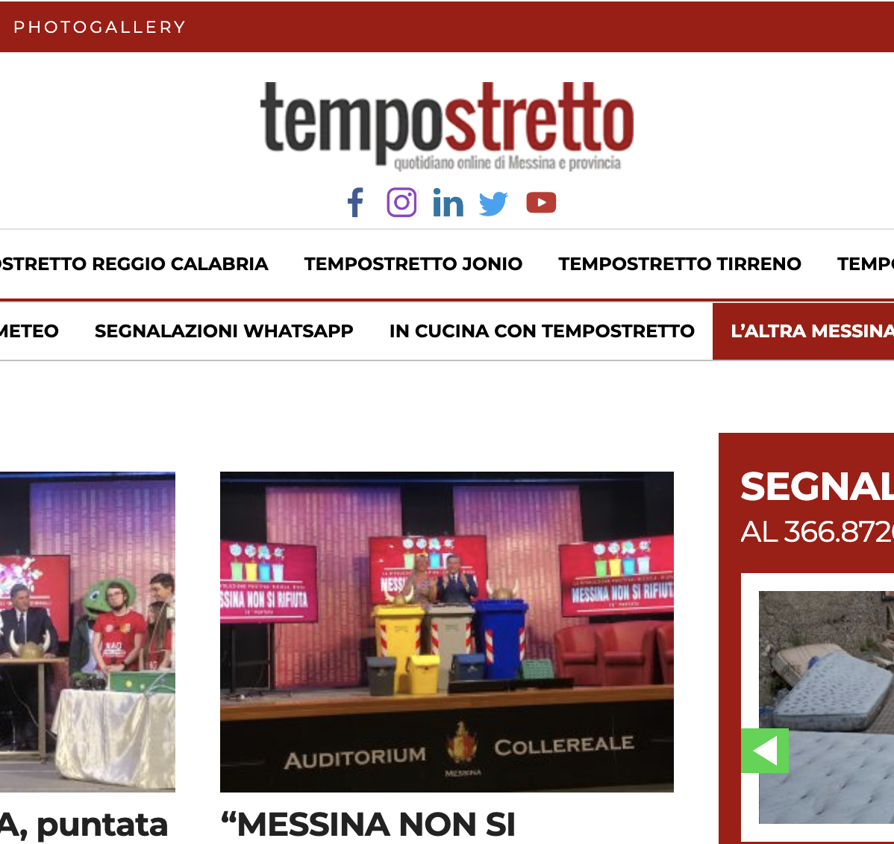
Visibility
Visibilità・Sichtbarkeit・Visibilité
Notes:
With our Open Data we can create a lot of cool stuff!
For example...
Alert System
We can build an alert system to inform citizens and tourists about incidents and important events.
Public Data Archive
We can build a public sensor data archive to keep track of environmental changes.
...

Slide 6
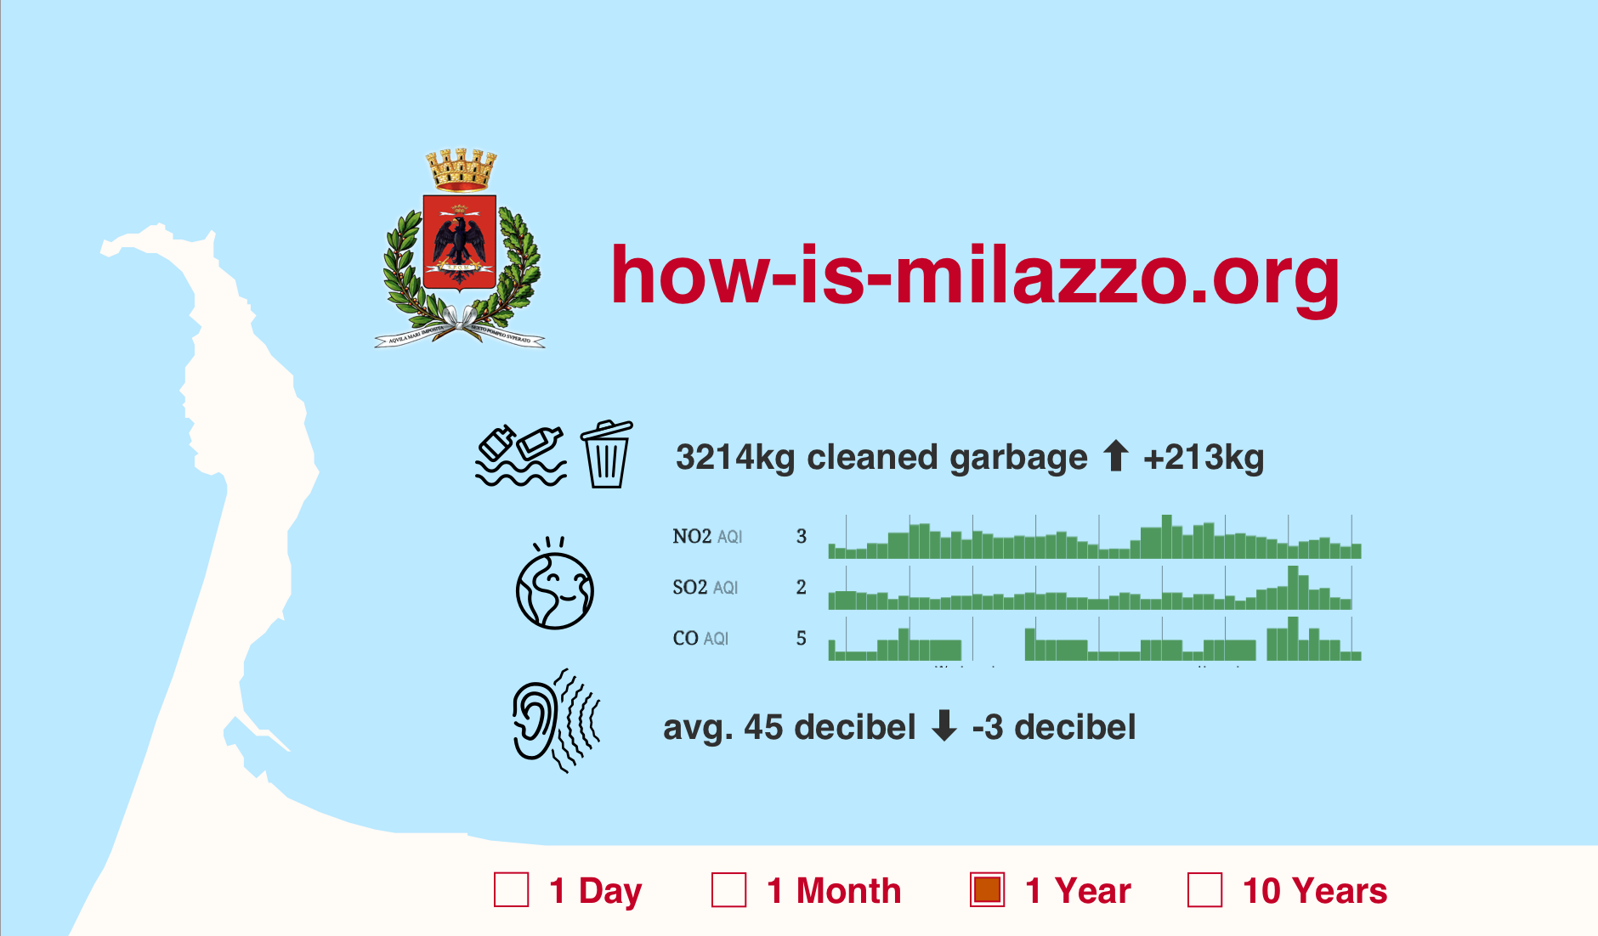
Notes:
Web Portal
We can build a web portal of Milazzo and present an image of the city.

Slide 7
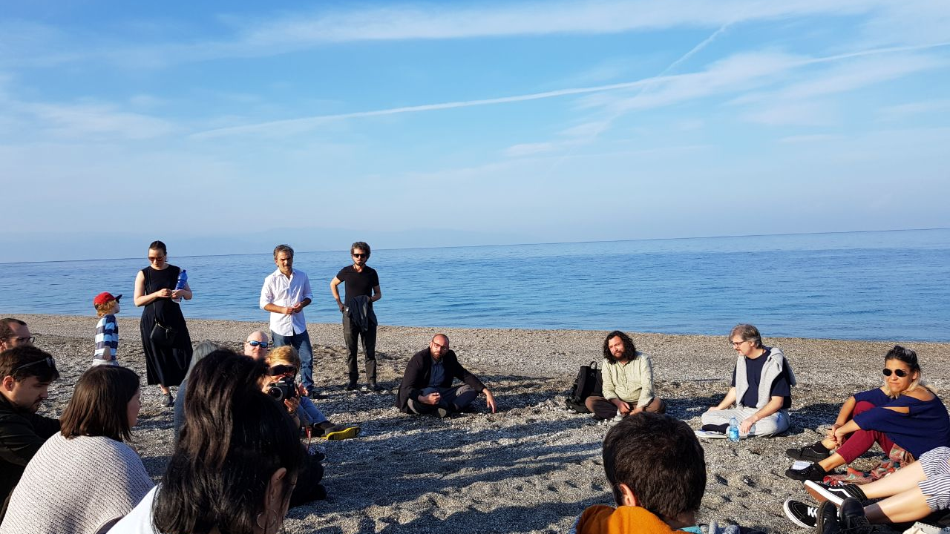
Community
Comunità・Gemeinschaft・Communauté
Notes:
Usually building something like this can costs a lot of money.
Others have got Money, We’ve got People!
There are lots of great people in Sicily!
Open Data Sicily
OpenStreetMap Milazzo
Ledger EU & Dyne
If you like this proposal and want to join, talk to us, join the community!

Slide 8
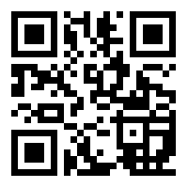
http://bit.ly/consento-milazzo

